Slide 1
E-book Landscape in Academic Libraries
Committee on Korean Materials Program
Miree Ku, Duke University
March 14, 2012

Slide 2
Why this topic?
To survey the e-book environment
To become knowledgeable about issues relating to e-books
To make strategic recommendations for developing Korean Studies e-book collection

Slide 3
E-book Statistics
International Digital Publishing Forum (IDPF)
  E-book statistics
Book Industry Study Group (BISG)
  Consumer Attitudes Toward E-Book Reading
Association of American Publishers (AAP)
  BookStats
Key indicators | Values | Notes
e-book market share in 2010 | 6.4% | 0.6% in 2008
e-book total net revenue in 2010 | $878 million | 114 million units sold

Slide 4
 | E-book issues
Access and Access Restriction Issues | Platforms Licensing Perpetual access Digital Rights Management
Collection Development Issues | Identify collection development criteria Selection: who selects, how, and how much Coordinate print and electronic formats to minimize duplication Usage statistics
Cost Issues | Pricing options Acquisition options Platform maintenance Funding
Technical Issues | Hardware (Devices) Software (Format) MARC records Efficient workflows in acquisitions and cataloging Perpetual access Authentication of eligible users, both on-and off-campus
Other Issues | Vendors, Aggregators, Publishers Shared digital contents Public domain titles

Slide 5
What are the main concerns?
Complex business models
Multiple platforms and formats
Complex licensing issues & DRM(Digital Right Management) restrictions
Ownership

Slide 6
Who are e-book providers?
Scholarly publishers
  Elsevier, Springer, Wiley, Sage, Oxford U Press, Duke U Press, Cambridge U Press, etc
  vendor, publisher and platform providers
Aggregators
  E-book Library (EBL), ebrary, eBook Collection (formally NetLibrary), MyiLibrary, etc
  vendor and platform providers
Consortia
  Credo, Project Muse, Books@JSTOR, etc
  Publisher and platform providers
Yankee Book Peddler
  vendor
  Not a platform provider

Slide 7
What business models are available?
Subscription
Purchase (Perpetual Archive)
  Multiple concurrent access
  Unrestricted, perpetual access by unlimited number of patrons
Patron (Demand) Driven Acquisition
Short-Term Loans
E-approvals

Slide 8
How can I choose an e-book acquisition model?
Why Subscribe?
  Unlimited multi-user access
  Affordable
Why Purchase?
  Archives titles in perpetuity
  No minimum purchase
  Single and multi-user access
  Many front-list titles
Why Patron Driven Acquisition?
  Ensure titles get used
  Archive titles in perpetuity
  Real-time profiling and collection management
  Generous triggers
Why Short-Term Loans?
  Provide on-demand access to titles
  Pay to rent only titles that are used
  Generous triggers
  Choose number of loans and duration
  Ability to use with Patron Driven Acquisition for mediation
Why e-book Approval Plan?
  Immediate access to preview the full text prior to its acquisition
  Power of the selector to refuse a title

Slide 9
Comparison of e-book Platforms
Providers (Platforms) | Software (Format) | Concurrency | Restrictions | Business Models
E-book Library (EBL) | No plug-ins or software Adobe Reader or Adobe Digital Editions for reading online/downloading | Simultaneous, multi-user access | Copy Print DRM used | Purchase with perpetual access (non-linear lending model or unlimited access) Demand-driven access
ebrary | Dedicated mobile app for iPad, iPhone and iPad ebrary QuickViewer Reader Adobe Digital Editions | Simultaneous, multi-user access | Copy Print Paste DRM used | Subscription Perpetual archive Patron driven acquisition Short-tem loans
EBSCO eBook collection (formally NetLibrary) | Adobe PDF format Adobe Digital Editions (free software) Adobe Reader for some ebooks | From a single simultaneous user to unlimited simultaneous user | Copy Print DRM used | Annual fee or Ongoing prepaid fee Content service and support fee
MyiLibrary | Adobe PDF format Web browser Adobe Acrobat Reader | Single user model Multiple user model (two to unlimited) | Copy Print Paste DRM used | Perpetual Access : single user price, multi user price, small annual access fee, download option annual fee Subscription Consortia price
Credo Reference | Web browser Adobe Reader | Unlimited, simultaneous users |  | Subscription

Slide 10
Additional features?
Search across text
Text highlighting
Dictionary assistance
Usage statistics
Abstracts provided
Deduplication
MARC records for online catalog
Exporting: Refworks, Endnote, Email etc
Linking: Title, Chapter, Page, Citation, Full text, MARC, Open URL, OPAC, etc
Indexing: Library of Congress, Dewey Decimal, BIC Subject Codes, etc

Slide 11
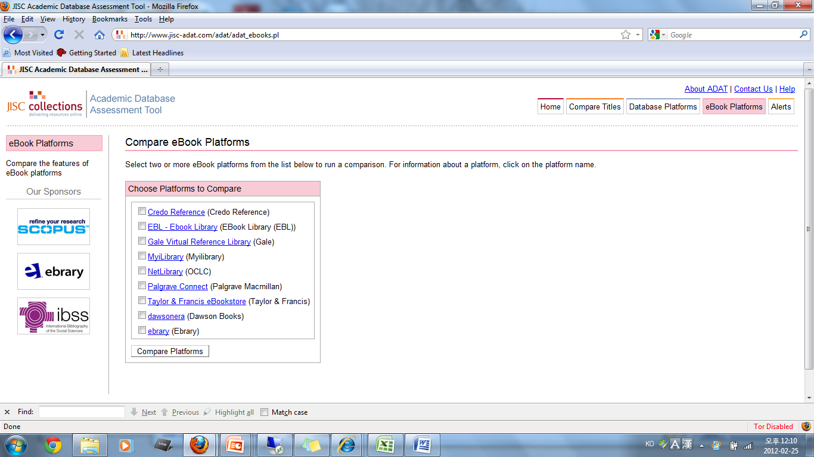
Compare eBook Platforms (JISC Academic Database Assessment Tool)

Slide 12
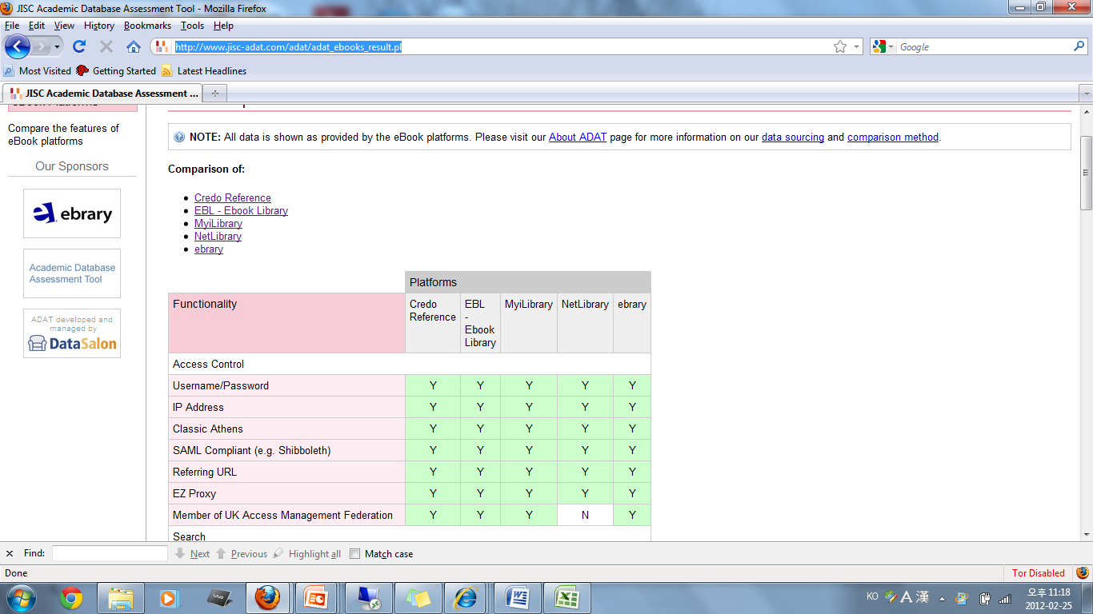
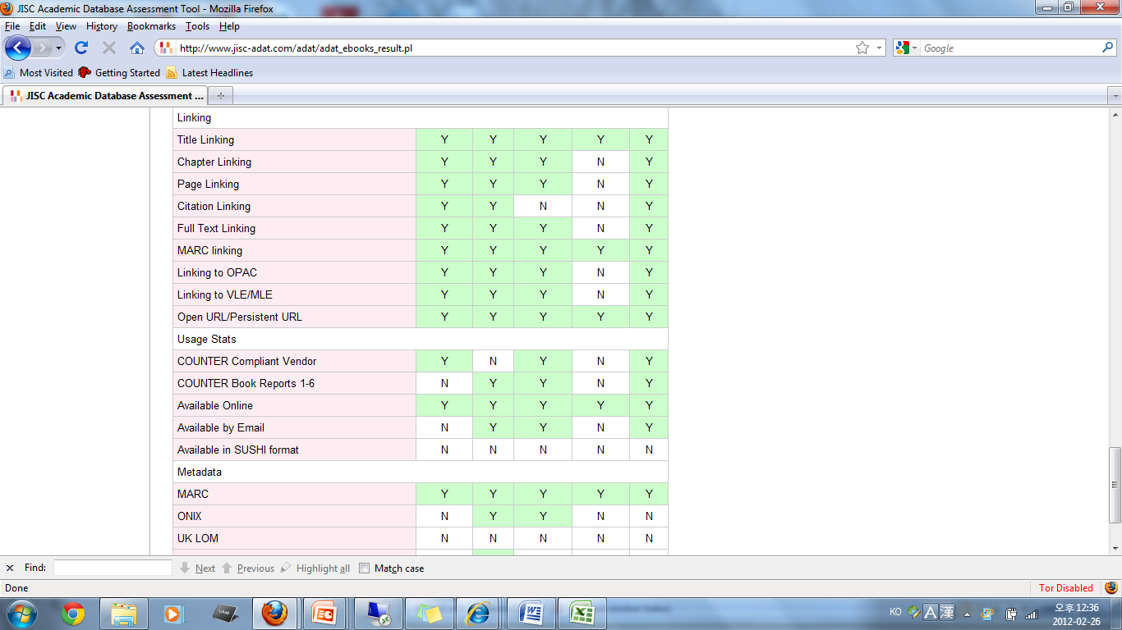
E-book Platforms Comparison Results

Slide 13
What are the main concerns?
Complex business models
Multiple platforms and formats
Complex licensing issues & DRM(Digital Right Management) restrictions
Ownership

Slide 14
Why so many different formats?
E-book Formats
  Plain text, HTML, PostScript, PDF, EPUB, Kindle, eReader, Mobipocket, etc
Advanced formats / Exclusivity
EPUB: Industry Standard Format
Converting between e-book formats
DRM (Digital Rights Management): anti-copying technology

Slide 15
Comparison of Popular e-book Formats
 | Plain text | HTML | PostScript | PDF | EPUB | Kindle | eReader | Mobipocket
File name extension | .txt | .html | .ps | .pdf | .epub | .azw | .pdb | .prc
DRM | No | No | No | Yes | Yes | Yes | Yes | Yes
Apple iPad | Yes | Yes | No | Yes | Yes | Yes | Yes | Yes
Android | Yes | Yes | No | Yes | Yes
Amazon Kindle 2, DX | Yes | No | No | Yes | No | Yes | No | Yes
Kindle Fire |  |  | No | Yes |  | Yes
Barnes & Noble Nook | No | No | No | Yes | Yes | No | Yes | No
Sony Reader | Yes | No | No | Yes | Yes | No | No | No

Slide 16
What are the main concerns?
Complex business models
Multiple platforms and formats
Complex licensing issues & DRM(Digital Right Management) restrictions
Ownership

Slide 17
What are the e-book licensing issues?
Issues on access and access restrictions
Number of users logged in simultaneously
Number of users who can view a specific e-book at once
Download or print restrictions due to DRM (Digital Right Management)
Select and copy texts from an e-book
Access e-book all at once or only by chapter
Search the text of an e-book
Specific software requirements for accessing e-books

Slide 18
What are the main concerns?
Complex business models
Multiple platforms and formats
Complex licensing issues & DRM(Digital Right Management) restrictions
Ownership

Slide 19
Who owns e-books?
Copyright
  a form of protection provided by the laws of the United States to the authors of original works of authorship (Reference: US Copyright Office)
Ownership of an e-book
  does not provide e-book copyright
Who has e-book copyright?
  Only the author of that book or someone who has been given rights by the author has that e-book copyright
Copyright protection using DRM
  DRM (Digital Rights Management) used by publishers to restrict what the users can do with e-books.
  Controls which devices the users can use to read e-books
  Prevents converting e-books from one format to another
  Restricts copying, printing, and/or sharing of digital resources
  Digital Restrictions Management???

Slide 20
More Questions?
Providers (Platforms) | Software (Format) | Concurrency | Restrictions | Business Models
E-book Library (EBL) | No plug-ins or software Adobe Reader or Adobe Digital Editions for reading online/downloading | Simultaneous, multi-user access | Copy Print DRM used | Purchase with perpetual access (non-linear lending model or unlimited access) Demand-driven access
What software is required for reading e-books?
How many users can access an e-book at one time?
Can patrons copy, paste, and print e-book content?
How is access managed for downloaded content?
Are e-books compatible with all reading devices(hardware)?
How are e-books priced?
Are MARC records provided?
What are the most advanced and commonly used devices in the current e-reader market?

Slide 21
Non English language e-book availability?
ebrary
    Spanish and Portuguese language materials
EBSCO eBook collection (formally NetLibrary)
  According to e-books new titles (total 4042 titles) on Feb 15, 2012
  English (3570), German (340), Japan (78), Spanish (23), French (21), Italian (8), China (1), Latin (1)
OverDrive
  Platform for public libraries with more than 700,000 digital titles
  Added thousands of foreign-language materials in more than 50 languages in January, 2012
  66 titles in Korean as of Feb 25, 2012 (all of them are ESL materials and children’s books)
Area for further development for international and area studies scholars

Slide 22
What challenges do we have?
Choose e-book platforms to meet the user’s needs
Negotiate pricing and licensing
Model Licenses
Minimize DRM restrictions
Advertise and Educate

Slide 23
Thanks!
Miree Ku
Duke University, Korean Studies Librarian miree.ku@duke.edu

